Slide 1
SPEEDY on Cortex–M3: Efficient Software Implementation of SPEEDY on ARM Cortex–M3
Hyunjun Kim, Kyungbae Jang, Gyeongju Song, Minjoo Sim, Siwoo Eum, Hyunji Kim, Hyeokdong Kwon, Wai-Kong Lee, and Hwajeong Seo

Slide 2
SPEEDY
Ultra Low-Latency Cipher
Targeting hardware security solutions built into High-end CPUs
High-end CPUs do not have the same restrictions on area and energy, but require significantly higher performance in terms of latency and throughput.
Block ciphers focused only on maximum encryption speed and high security
Algorithm design considering hardware gate and transistor level latency characteristics
As a result, single-cycle encryption performs better than known traditional ciphers.

Slide 3
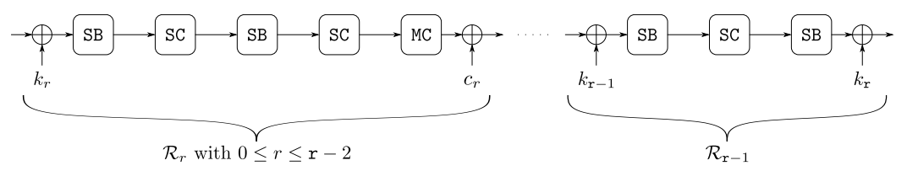
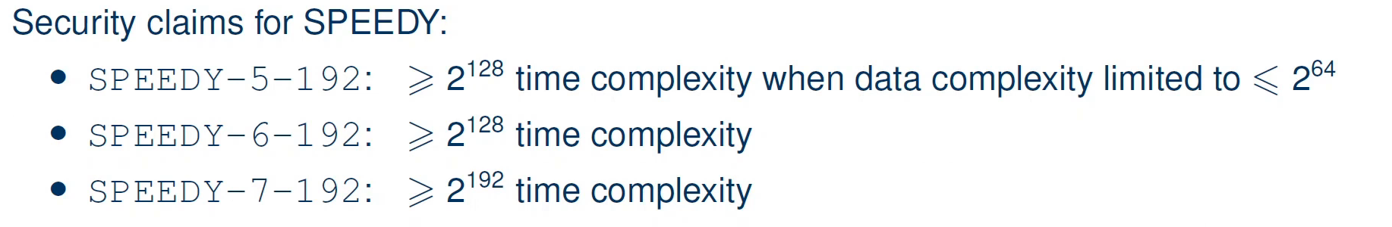

SPEEDY
SPEEDY-r-6$ℓ$ is an instance of this family with block and key size 6$ℓ$ bits and it iterates over r rounds.
Internal state : $ℓ × 6 \text{rectangle} \text{array} \text{of} \text{bits}$
Four different operation : SubBox, ShiftColumns, MixColumns, AddRoundConstant and AddRoundKey
In the last round, linear layer and constant addition are omitted and key addition is applied instead.

Slide 4
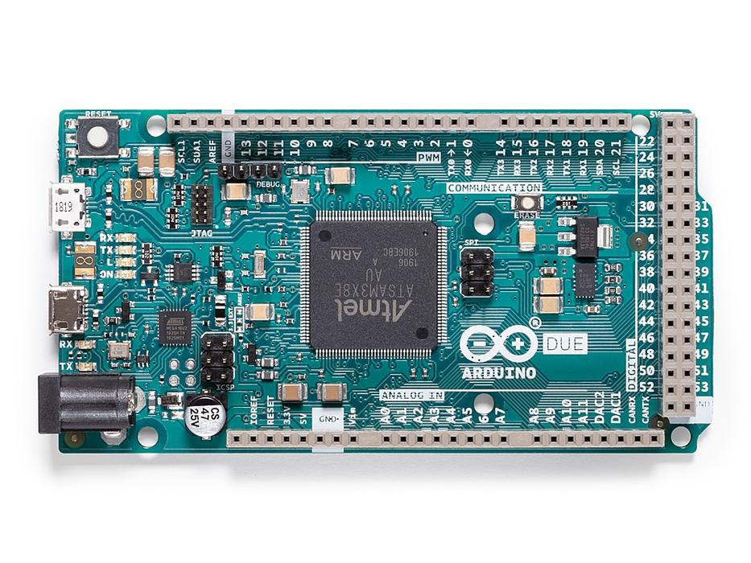
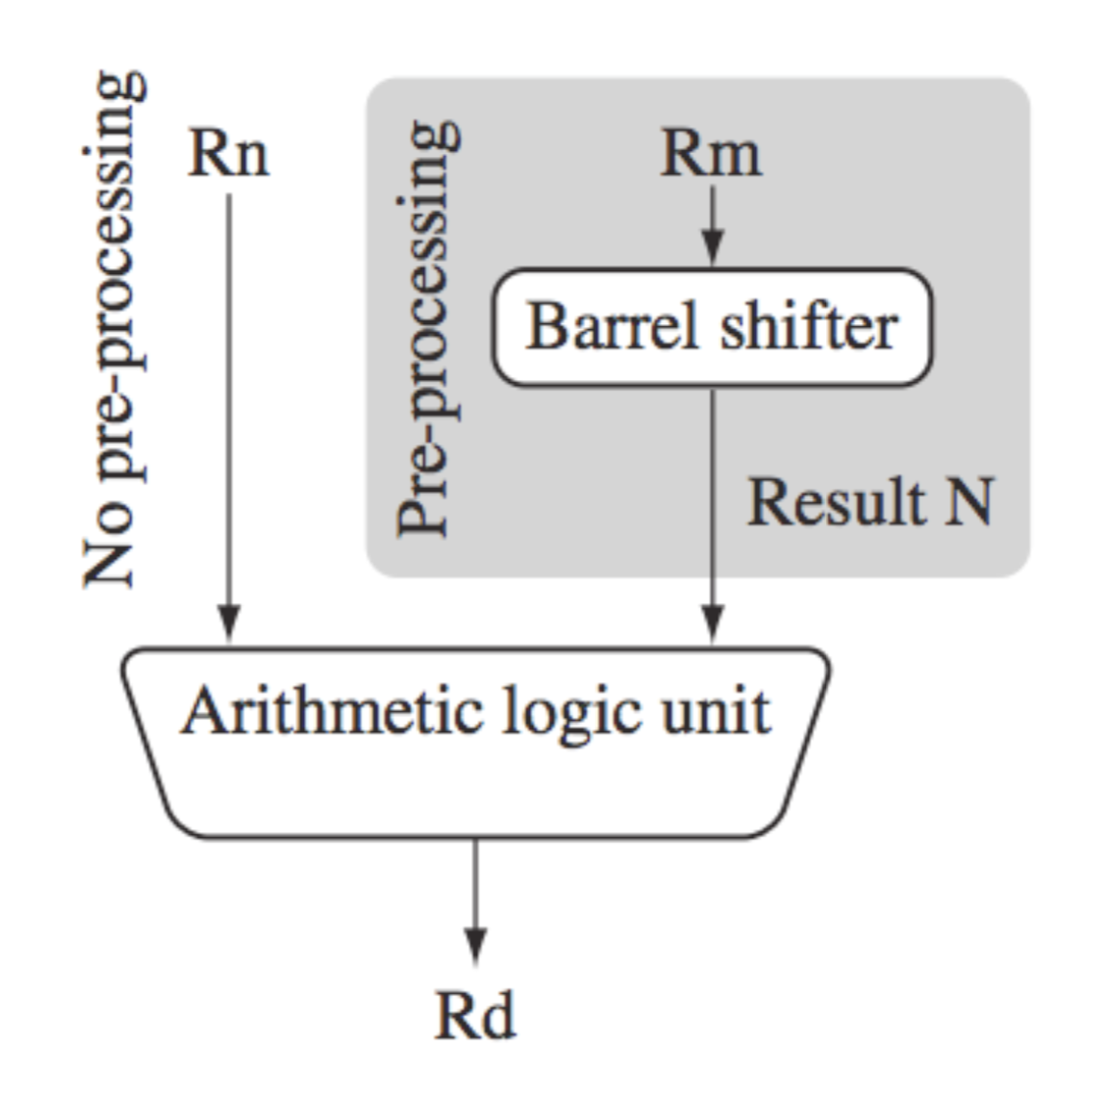
Implementation Platform
ARM Cortex-M3
Cortex-M (Microcontroller): Specialized in low-power design Used for IoT, industrial and home devices
ARM ALU supports 32-bit barrel shifters with shift and rotation operations
Two operations, including shift and rotation operations, are possible in one instruction
Architecture | Instruction Set | Remarks
~ARMv4 | ARM | ARM : Consists of 32-bit instructions
ARMv4T ~ ARMv6 | ARM + Thumb | Thumb : Consists of 16-bit instructions
ARMv7 | ARM + Thumb2 | Thumb2 : Consists of 16-bit and 32-bit instructions
MOV r3, r3, ROR #16
ADD r4, r4, r4, LSL #4
Arduino DUE (84Mhz, 512KB ROM, 96KB RAM)

Slide 5
Motivation
Hardware-oriented block ciphers are generally less efficient in software implementations
However, in previous studies, hardware-oriented block ciphers PRESENT and GIFT were efficiently implemented in software.
Reis et al.* improved best assembly implementation on existing Cortex-M3 by 8x over previous work by using new permutations, optimized Boolean formulas, and bit slicing implementation of S-box instead of lookup tables
Adomnicai et al.** performed a very efficient software implementation of GIFT with a new technique called Fix-slicing using only a few rotations that outperformed the AES constant-time implementation on the then-best existing Cortex-M3 at the time.
Is it possible to efficiently implement SPEEDY on software?
* T. Reis, D. Aranha, and J. Lo ́pez, “PRESENT runs fast,”
** A. Adomnicai, Z. Najm, and T. Peyrin, “Fixslicing: A new GIFT representation: Fast constant-time implementations of GIFT and GIFT-COFB on ARM Cortex-M,”

Slide 6
Contribution
Efficient implementation of SPEEDY software will increase the competitiveness of SPEEDY.
SPEEDY's 6-Bit S-box and Bit Permutations
inefficient in software
6-Bit S-box operation Requires many registers and instructions
Bit exchange between multiple registers is not software-friendly
Efficient software implementation goal in embedded environment
Implemented on a Cortex-M3 microcontroller
Apply bit slicing implementation technique
Parallel operation of S-Box, ShiftColumns, MixColumns
Optimization with Barrel Shifter
Efficient bit slicing, Packing and ShiftColumns, MixColumns
Optimizing logical operations

Slide 7
Bitslicing
First used by Eli Biham for fast DES implementation
Expressing functions as single-bit logical operations ( AND , XOR , OR , NOT , etc.), much like implementing a logic circuit in hardware.
The CPU then uses bitwise operations to perform multiple instances of the function in parallel
Advantages of speed, parallelism, and constant execution time
Block
Block 1
Block 2
Block 3
Block N-2
Block N-1
Block N
Register 1
1 | 1 | 0 | 0 | 1 | 0 | 0 | 1
Register 1
1
1
0
0
1
0
0
1
0
1
1
0
0
0
0
1
1
0
1
0
1
0
1
0
Block
Register 2
Register 2
0 | 1 | 1 | 0 | 0 | 0 | 0 | 1
Register 3
Block
···
Register 3
1 | 0 | 1 | 0 | 1 | 0 | 1 | 0
Register 4
Register 5
···
Register 6
Register 7
Register 8

Slide 8
Packing
Packing : Change to Bitslicing representation
Cortex-M3 can pack efficiently with swpmv technique
bit swaps between the nibbles
.macro swpmv out0, out1, in0, in1, m, n, tmp
eor \tmp, \in1, \in0, lsr \n
and \tmp, \m
eor \out1, \in1, \tmp
eor \out0, \in0, \tmp, lsl \n
.endm
ex) 16bit plantext (4bit * 4 block) , 4bit register
0 | 1 | 2 | 3 | 4 | 5 | 6 | 7 | 8 | 9 | 10 | 11 | 12 | 13 | 14 | 15
R0
0 | 1 | 2 | 3
4 | 5 | 6 | 7
8 | 9 | 10 | 11
12 | 13 | 14 | 15
0 | 4 | 2 | 6
1 | 5 | 3 | 7
8 | 12 | 10 | 14
9 | 13 | 11 | 15
0 | 4 | 8 | 12
1 | 5 | 9 | 13
2 | 6 | 10 | 14
3 | 7 | 11 | 15
R1
R2
Twice Swpmv
Twice Swpmv
R3

Slide 9
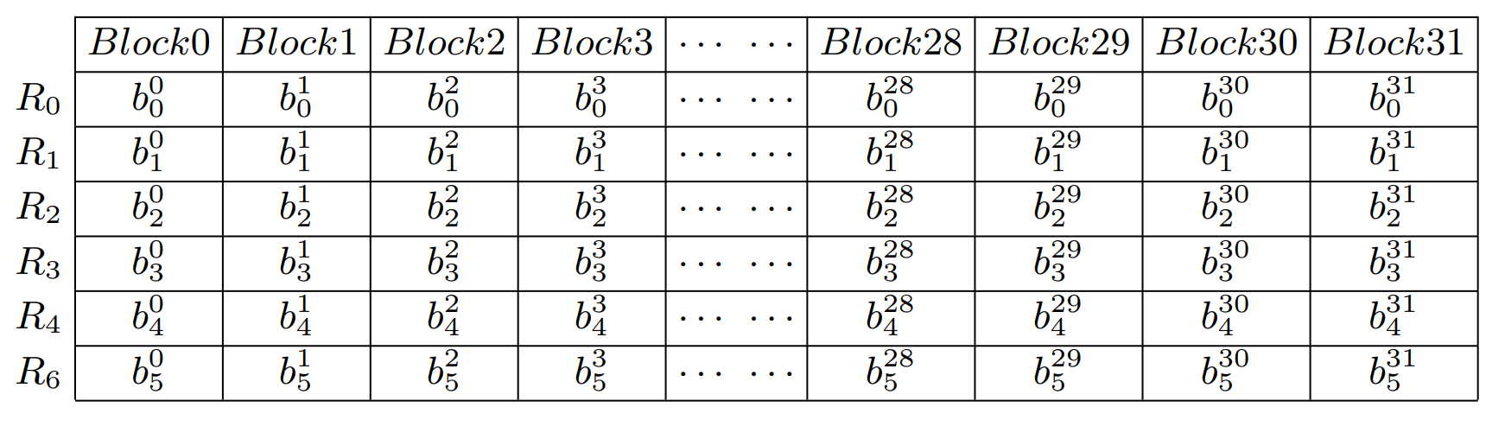
Packing - SPEEDY
Problem: When fetching 192-bit plaintext, it is stored in 6 32-bit registers.
Several blocks are truncated and stored in different registers.
32bit
0 | 1 | 2 | 3 | 4 | 5/
5/ | 6 | 7 | 8 | 9 | 10/
10/ | 11 | 12 | 13 | 14 | 15
16 | 17 | 18 | 19 | 20 | 21/
21/ | 22 | 23 | 24 | 25 | 26/
26/ | 27 | 28 | 29 | 30 | 31
6 register

Slide 10
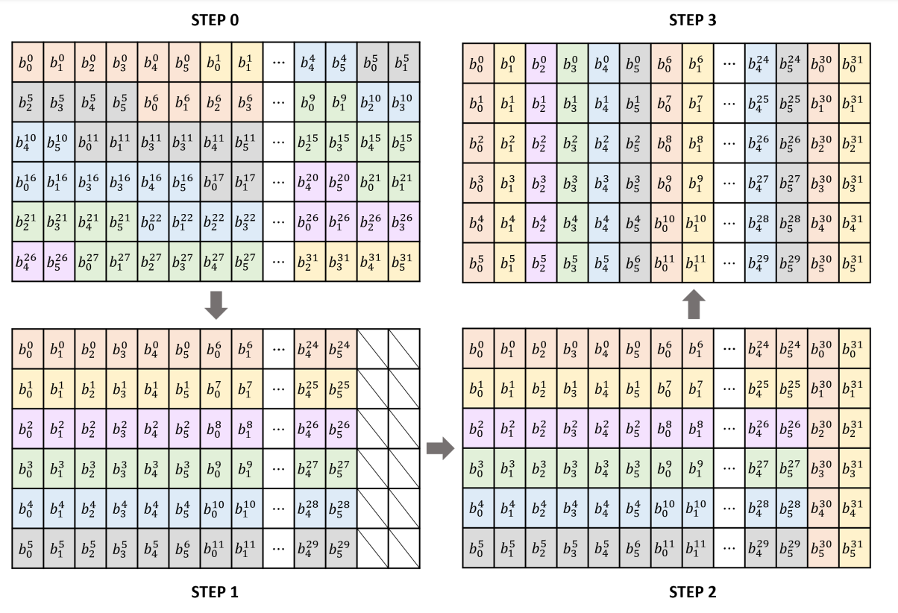
Packing - SPEEDY
Goal of maximizing use of swpmv
STEP 0: Plaintext stored in 6 32-bit registers
STEP 1: Save the i-th block in the R(i%6) register except for the 31st and 32th blocks
STEP 2: Store the 31st and 32nd block bits as columns in the last 2 bits of each register
STEP 3: Sort the remaining blocks into Bitslicing representation using swpmv
swpmv

Slide 11
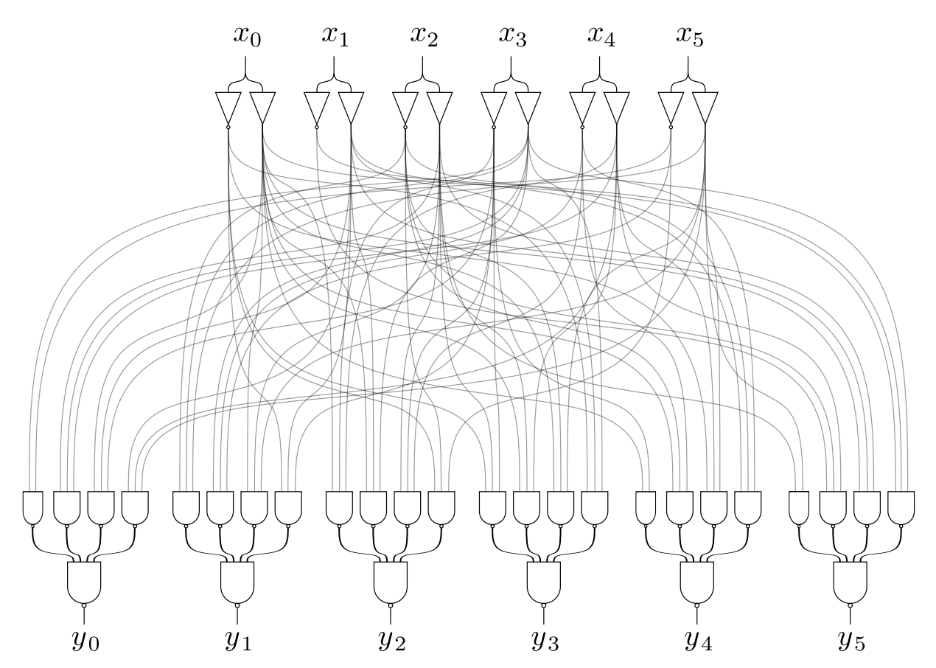
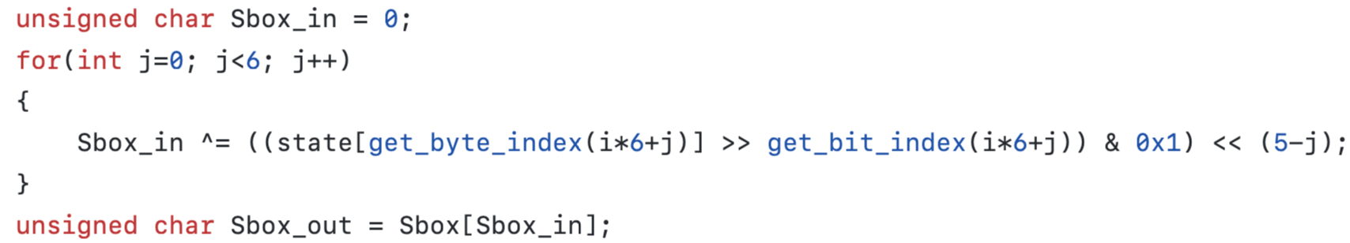
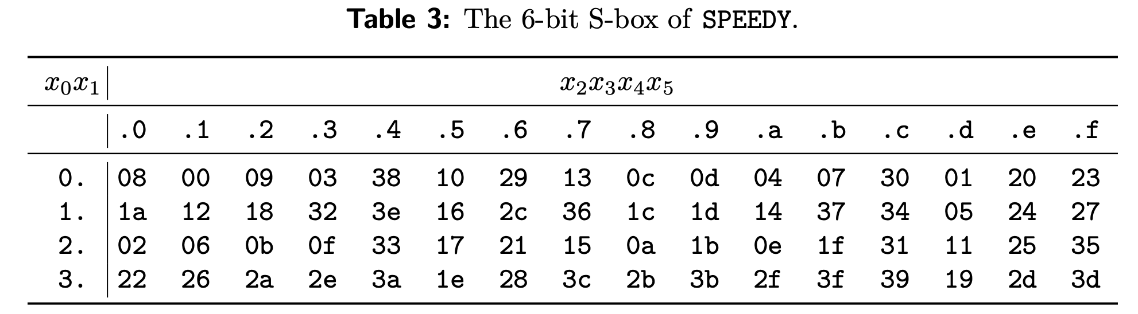
Previous S-box
SubBox (SB)
Using S-box table

Slide 12
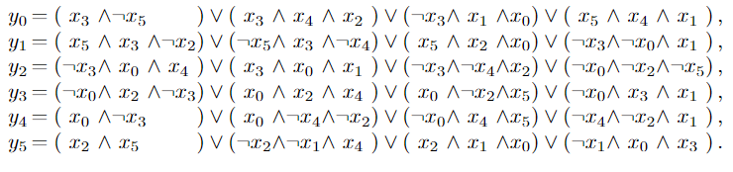
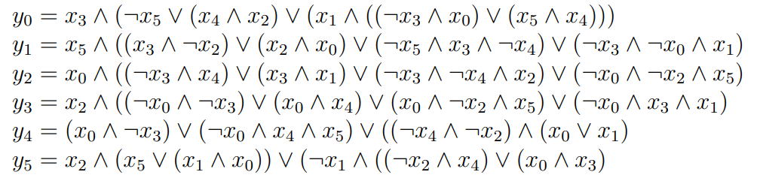
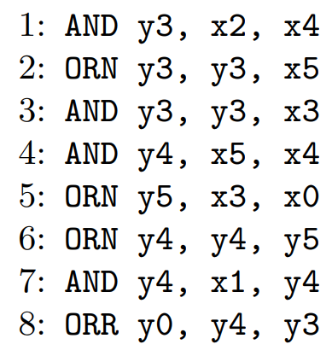

Proposed S-box
Using logical representation of S-box
Bit slicing implementation allows 32 blocks to be computed in parallel
We use the rule of logical operators to reduce the number of logical operations
However, Cortex-m3 supports NOR operation instruction but does not support NAND operation instruction.
Change to NOR operation with optimization.
Only 3 commands are used.

Slide 13

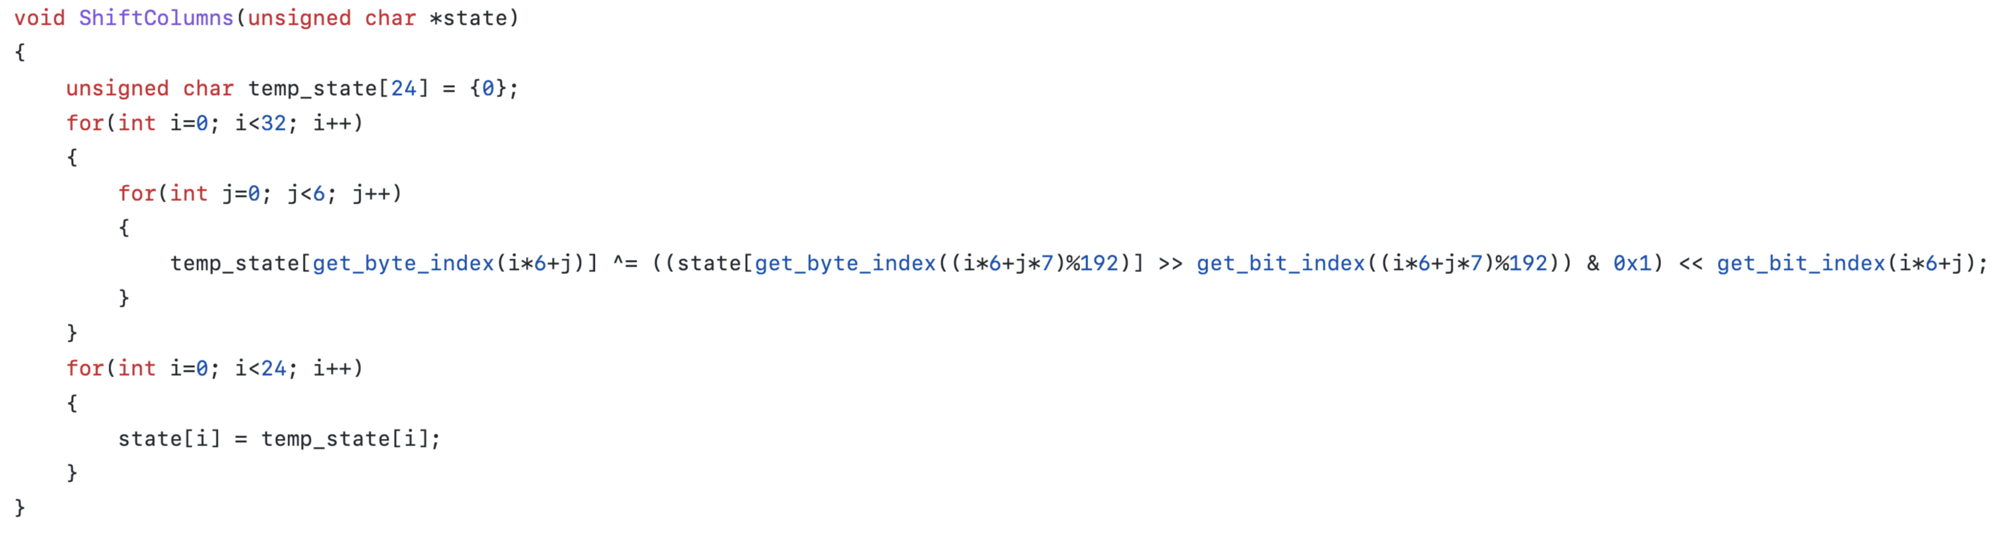
Previous ShiftColumns
ShiftColumns (SC): The j-th column of the state is rotated upside by j bits.
Inefficient in the format of 8 x 24 bits
It matches the processing unit of the computer, but the block is 6 bits, so it is computed inefficiently

Slide 14
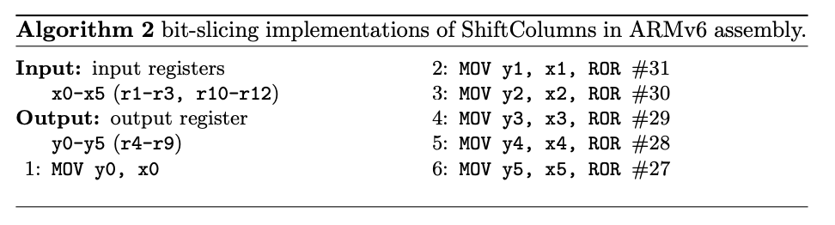
Proposed ShiftColumns
In Bitslicing expression, column movement of bits is changed to row movement.
Shifting Columns of Bits - Exchange of Bits Between Registers
Row shift of bits - rotation in a single register
Calculation with other operations is possible using the barrel shifter
Block
 | 0 | 1 | 2 | 3 | 4 | 5 | ···
1 | 1 | 1 | 1 | 1 | 1 | 1 | ···
2 | 2 | 2 | 2 | 2 | 2 | 2 | ···
3 | 3 | 3 | 3 | 3 | 3 | 3 | ···
4 | 4 | 4 | 4 | 4 | 4 | 4 | ···
5 | 5 | 5 | 5 | 5 | 5 | 5 | ···
6 | 6 | 6 | 6 | 6 | 6 | 6 | ···
 | 0 | 1 | 2 | 3 | 4 | 5 | ···
1 | 1 | 1 | 1 | 1 | 1 | 1 | ···
2 | 2 | 2 | 2 | 2 | 2 | 2 | ···
3 | 3 | 3 | 3 | 3 | 3 | 3 | ···
4 | 4 | 4 | 4 | 4 | 4 | 4 | ···
5 | 5 | 5 | 5 | 5 | 5 | 5 | ···
6 | 6 | 6 | 6 | 6 | 6 | 6 | ···
Register
Register
<<<1
Register
<<<2
Register
<<<3
Register
<<<4
Register
<<<5

Slide 15
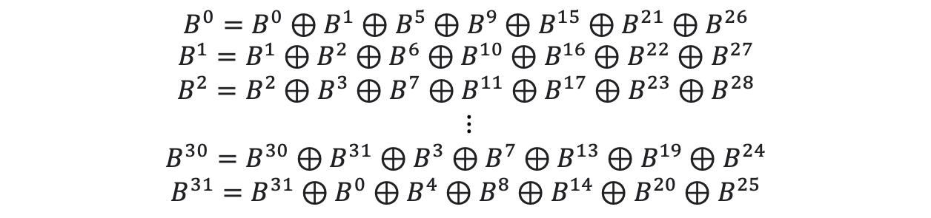
Previous MixColumns
MixColumns (MC): A cyclic binary matrix is multiplied to each column of the state.
Inefficient in the format of 8 x 24 bits
It matches the processing unit of the computer, but the block is 6 bits, so it is computed inefficiently
$$B^{0}=B^{0}⊕B^{1}⊕B^{5}⊕B^{9}⊕B^{15}⊕B^{21}⊕B^{26}$$
$$B^{1}=B^{1}⊕B^{2}⊕B^{6}⊕B^{10}⊕B^{16}⊕B^{22}⊕B^{27}$$
$$B^{2}=B^{2}⊕B^{3}⊕B^{7}⊕B^{11}⊕B^{17}⊕B^{23}⊕B^{28}$$
$$⋮$$
$$B^{30}=B^{30}⊕B^{31}⊕B^{3}⊕B^{7}⊕B^{13}⊕B^{19}⊕B^{24}$$
$$B^{31}=B^{31}⊕B^{0}⊕B^{4}⊕B^{8}⊕B^{14}⊕B^{20}⊕B^{25}$$

Slide 16
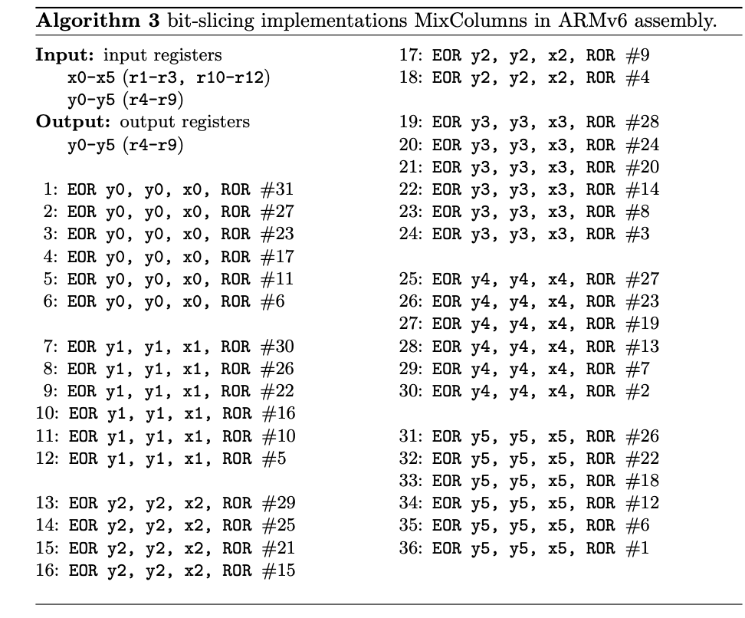

Proposed MixColumns
In Bitslicing expression, column movement of bits is changed to row movement.
just after rotation xor
32 blocks are computed in parallel with 36 EOR instructions.
x is the register where the SB operation result is stored
y is the register where the SC operation result is stored
Efficient use of registers by recycling the results of previous operations.
⊕
$$⋘α_{}$$

Slide 17
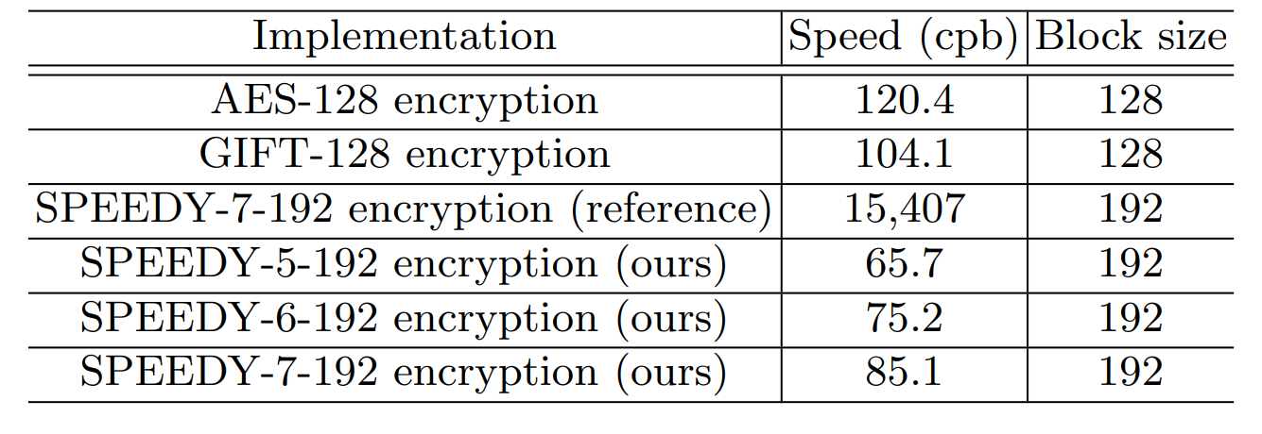
Cipher Comparison
Environment
Arduino IDE on the ArduinoDUE (AT91SAM3X8E) development board equipped with an ARM Cortex-M3 processor
The operating clock is 84 MHz, and it has 512 KB of flash memory and 96 KB of RAM.
Performance comparison measured the average cycle when encrypting.
Key scheduling is not taken into account as it is assumed that round keys are pre-computed and stored in RAM.
Reference, Comparison with AES-128 and GIFT-128: 180x, 1.6x, 1.3x speed improvement, respectively

Slide 18
Conclusion
Efficient software implementation in embedded environment by applying hardware-oriented block cipher SPEEDY implementation technology of bit slicing
If the round key is calculated in advance, SPEEDY-5-192 achieves 65.7 cpb, SPEEDY-6-192, 75.25 cpb, and SPEEDY-7-192, 85.16 cpb in ARM Cortex-M3, realizing 120.4 cpb of GIFT-128 better performance than 104.1cpb of AES-128
Confirmed that SPEEDY can be run very efficiently in software and can be applied to microcontrollers
In addition, it operates with a constant timing, which is advantageous for timing attacks.

